Slide 1


Slide 2
Context
Small RNA-seq Analysis of
Drosophila melanogaster loqs Mutants
There are 3 known isoforms of the LOQs gene in Drosophila melanogaster, LOQs-PA, PB, PD. They are all known to be implicated in small RNA (sRNA) processing.
Studying the sRNA transcriptome of various loqs mutants.
Libraries were constructed by rescuing loqs-KO individually with either LOQs-PA, PB or PD.

Slide 3
Context

Slide 4
Context
Which region/feature do we attribute the read to?
Shorter read length
Higher probability to map to multiple regions of genome
Tends to originate from highly repetitive, paralogous loci
Longer read length
Lower probability to map to multiple regions of genome
Tends to originate from single loci
Notes:
Differential expression
problem. A major issue is the
prevalence ofmulti-mapping (MMAP) reads in sRNA-seq data.MMAP
reads occur when there are multiple best-scoring alignments to the
reference genome. MMAP reads are quite rare in modern polyA+
mRNA-seq data due to their longer read-lengths, and due to the fact
that polyA+ mRNAs generally are transcribed from single-copy sequences.
In contrast, MMAP reads are much more frequent in sRNAseq
data due both to the short lengths of the reads, and their tendency to
originate fromhigher-copy number regions of the genome. Endogenous
siRNAs are known to come from repetitive regions of many genomes
(Matzke and Mosher 2014), while identical miRNAs are often encoded
by multiple paralogous loci

Slide 5
Context
How are Multi-Mapping Reads (MMAP) conventionally dealt with?
Ignored/ discarded
“Best” single alignment is chosen
“Randomly Placed” - Given a read that has a 100 counts and maps to 5 different genomic regions, it is assumed that 20 counts map to each region (in other words, total counts / number of mapped locations)
Current Solution to > 80% of loqs library reads.

Slide 6
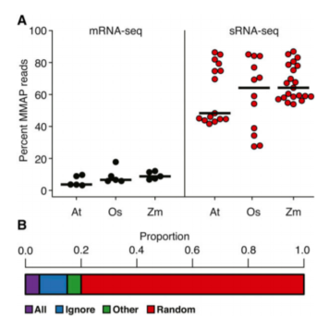
Context
How significant is this problem?
Notes:
Differential expression
problem. A major issue is the
prevalence ofmulti-mapping (MMAP) reads in sRNA-seq data.MMAP
reads occur when there are multiple best-scoring alignments to the
reference genome. MMAP reads are quite rare in modern polyA+
mRNA-seq data due to their longer read-lengths, and due to the fact
that polyA+ mRNAs generally are transcribed from single-copy sequences.
In contrast, MMAP reads are much more frequent in sRNAseq
data due both to the short lengths of the reads, and their tendency to
originate fromhigher-copy number regions of the genome. Endogenous
siRNAs are known to come from repetitive regions of many genomes
(Matzke and Mosher 2014), while identical miRNAs are often encoded
by multiple paralogous loci

Slide 7
Improved Placement of Multi-mapping Small RNAs
Initial Assumption and Objective
Each read in a sRNA-seq experiment represents a single small RNA molecule, which therefore must have had a single genomic origin
Goal of this package is to identify the site of transcriptional origin of the small RNAs
Mapping Modes
Bowtie multiple-alignment to reference genome, keeping MMAPs <= 50 positions
Random Placement (R)
Fractional – Weighting
(F)
Unique -Weighting (U)
Notes:
When run in modes U or F, MMAP reads for which the computed
probabilities at all positions are equal remain a random guess. In those
cases, such reads will be suppressed entirely (marked as unmapped) if
they hadmore than three possible alignment positions (this threshold is
user-adjustable).

Slide 8
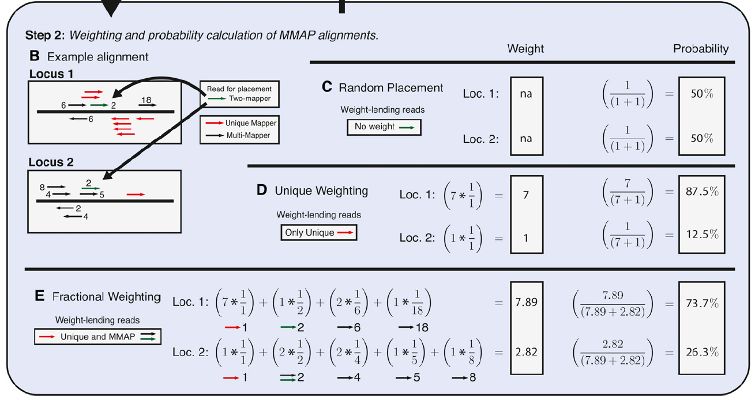
Context
Improved Placement of Multi-mapping Small RNAs
Notes:
Have different “neighborhoods” of adjacent alignments of other reads and the goal is to assign the probability weightage to each location.
How are neighborhoods defined? reference genome into 50-nt bins, 250nt- window centered around the alignment in question.
Unique-weighting. Given all the mapped regions, calculate total unique mappers within multiple regions.
Then use that number as denominator. the frequencies of uniquely aligned reads mapping within the
vicinity of the alignment under consideration are tallied.
Fractional weighting:. This takes into account multiple mappers in the vicinity. TThe higher the MMAP value, the lower it contributes to score. Then each region’s score is expressed as a fraction of (all region) score. The fractional method (F) uses all reads mapping within the vicinity of an alignment. Unique reads in the vicinity lend full weight, while MMAP reads provide weights inversely proportional to their MMAP-value.
What is the theory behind all of this?

Slide 9
Improved Placement of Multi-mapping Small RNAs
Context
Experimental validation
Obtained sRNA-seq libraries from Arabidopsis thaliana, Oryza sativa, and Zea mays.
Also generated a simulated library based on the properties of real datasets from the above organisms, with reads generated from chosen sRNA loci.
Precision and Sensitivity
True positives (aligned reads that are put in the correct position; TP),
False positives (aligned reads that are put in the incorrect position; FP)
True negatives (unaligned reads that have no possible alignment position; TN)
False negatives (unaligned reads where there is at least one valid alignment position; FN)
Precision = [TP / (TP + FP)]
Sensitivity = [TP / (TP + FN)]
Notes:
sRNA-seq libraries from Arabidopsis thaliana, Oryza sativa, and Zea mays, and also a simulated library This process was accomplished through a custom python
script and wrapper run under default settings: sRNA-simulator.py.
Five million reads were then generated from these simulated loci, generating roughly 3.25 M hc-siRNA, 1.5 M miRNA, and 250 k tasiRNA reads.
Loci were made to approximate real loci in size and pattern, Unlike real data, simulated reads are traceable to their
loci of origin, and thus are suitable to discern correct placements from incorrect ones.
Specifically, we can count true positives (aligned reads
that are put in the correct position; TP), false positives (aligned reads that
are put in the incorrect position; FP), true negatives (unaligned reads that
have no possible alignment position; TN), and false negatives (unaligned
reads where there is at least one valid alignment position; FN).

Slide 10
Experimental Simulation
Context

Slide 11
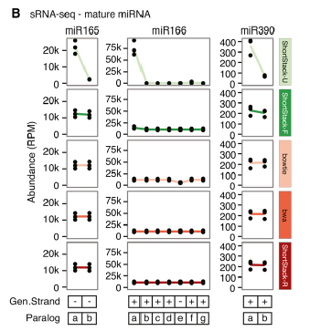
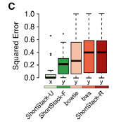
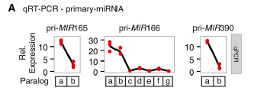
qRT-PCR Experimental Validation
3 pri-miRNA transcripts were chosen for qRT-PCR analysis
ShortStack-U mode also shows the lowest sum of residual squared error, reflecting the least discrepancy between actual data and the multiple mappings.
ShortStack-U mode produced mappings that were the most similar to the qRT-PCR results.
Notes:
sum of squared residual, used to measure the discrepancy between the data and an estimation model.

Slide 12
Further Experimental Validation
Identified known sRNA precursors which map uniquely to the genome,
i.e 1 site of origination
Fragment in to 24nts, align fragments using ShortStack

Slide 13
Conclusion
Given a MMAP read, the ultimate objective is to (as best as possible) allocate a probability weightage to each of its multi-mapping sites and accurately allocate counts.
By using a proximity-based weightage system, ShortStack-U appears to be significantly superior to our existing “Random Allocation” method of assigning probability weightages to MMAPs.
Cons? Too good to be true? Not a huge amount of citations since last year? Might have to reconfigure a significant part of existing pipeline to use it.
Notes:
Short-
Stack-U gives fewer false positives for MMAP reads than all other
methods for sRNA-seq alignment (Figure 4, Figure 5, and Figure 7). The
experimental evidence identifying miRNA alignment is striking, as
mature miRNAs are remarkably poorly placed through standard approaches
(Figure 6). It is likely that misalignment of this nature is
significantly misrepresenting the abundance of many loci, conceivably
resulting in misannotations. ShortStack-U’s alignment method reduces
these risks, striking a balance between precision and sensitivity.
A method that is capable of identifying the true site of origin for all

